Slide 1
Automated Fabric Defect Detection and Classification
DKM Consultant Ltd

Slide 2
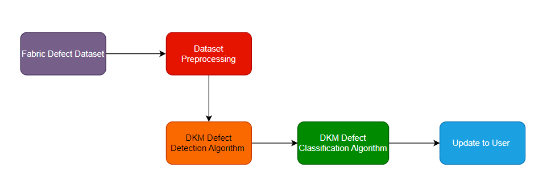
High Level AI Flow

Slide 3
AI Approach
DKM’s AI-based automated fabric defect detection algorithm utilizes pre- trained deep neural network models for classifying possible fabric defects.
The fabric images are enhanced by pre-processing at various levels using conventional image processing techniques and they are used to train the networks.
The Deep Convolutional Neural Network (DCNN) and a pre-trained network, AlexNet, are used to train and classify various fabric defects.
With current capability, the detection and classification system based on this classifier model can aid the human to find faults in the fabric manufacturing unit.

Slide 4
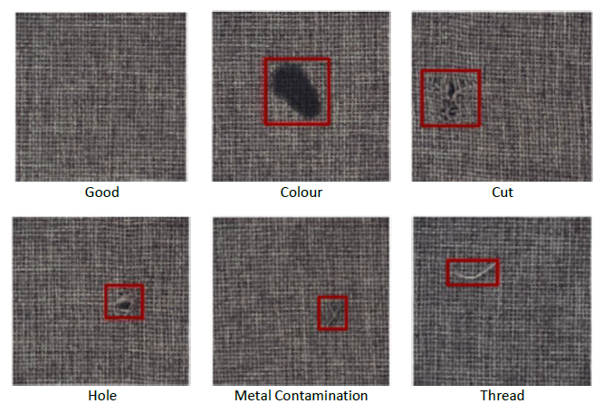
Real time image samples of defects

Slide 5
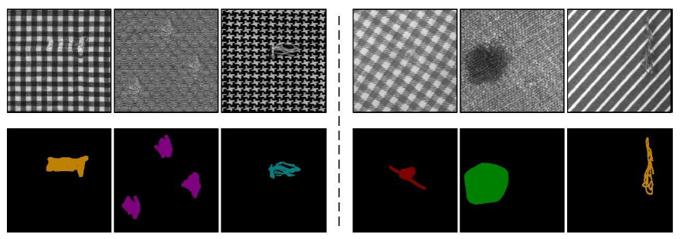
DKM’s AI Strategy

Slide 6
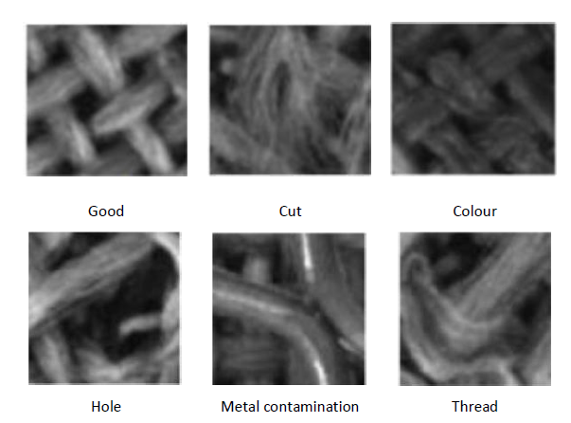
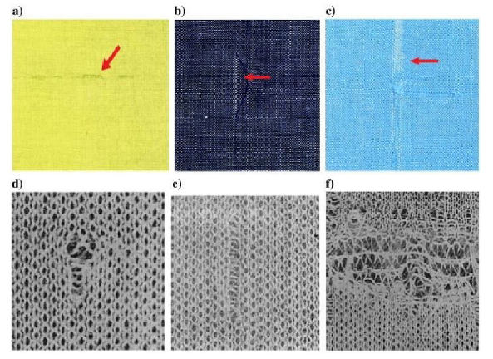
Image Appearance during AI Workflow

Slide 7
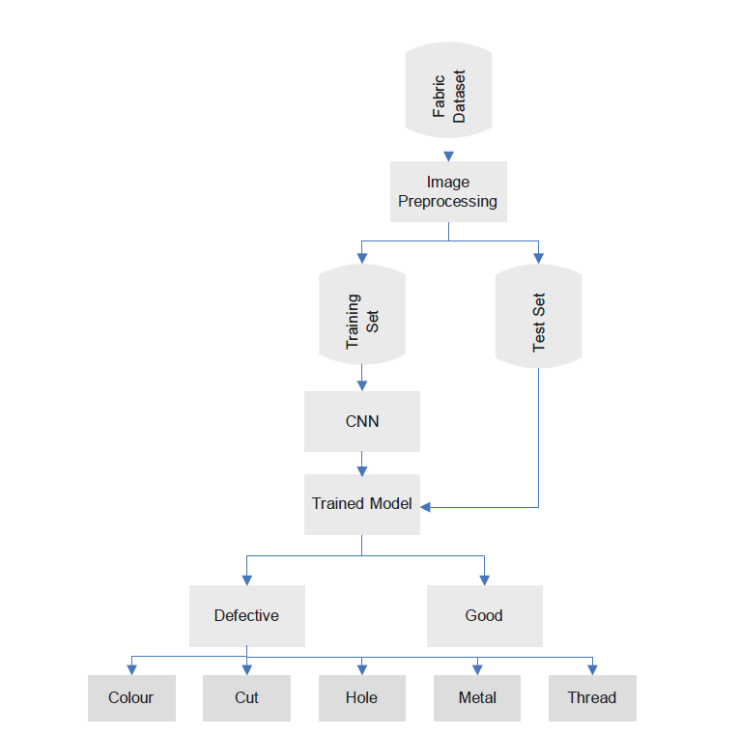
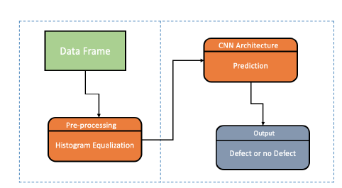
Fabric defect detection system

Slide 8
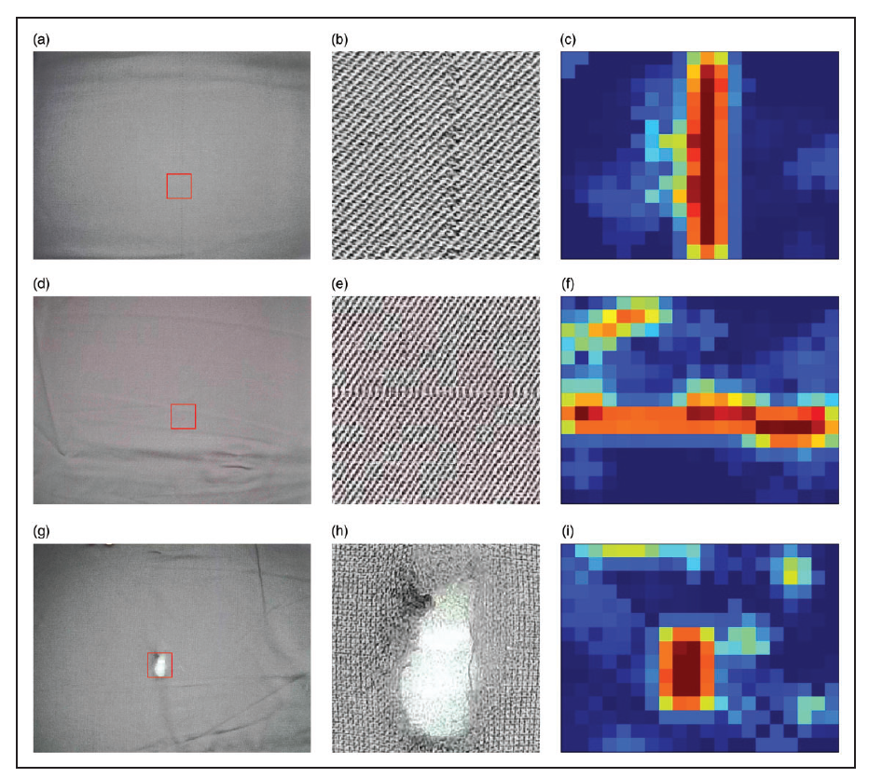
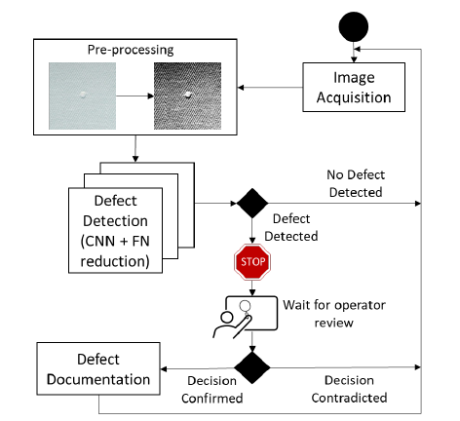

Slide 9
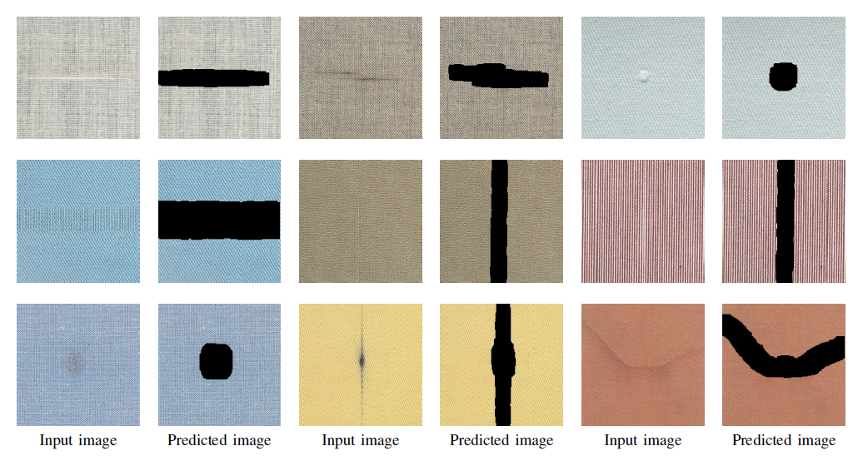
How to AI Model output looks like?

Slide 10
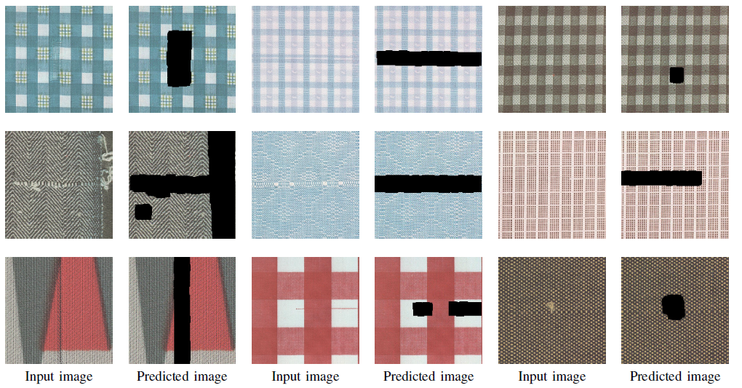

Slide 11
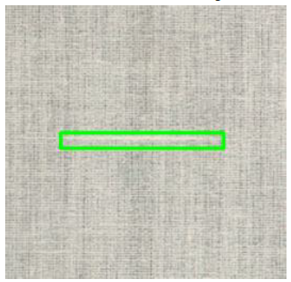
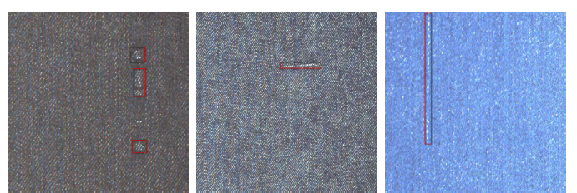
Pixel by Pixel Comparison
Three kinds of defects on the fabric surface. (a) Regional defects in fabrics; (b)Weft defect
in fabric; (c)Warp defect in fabric

Slide 12
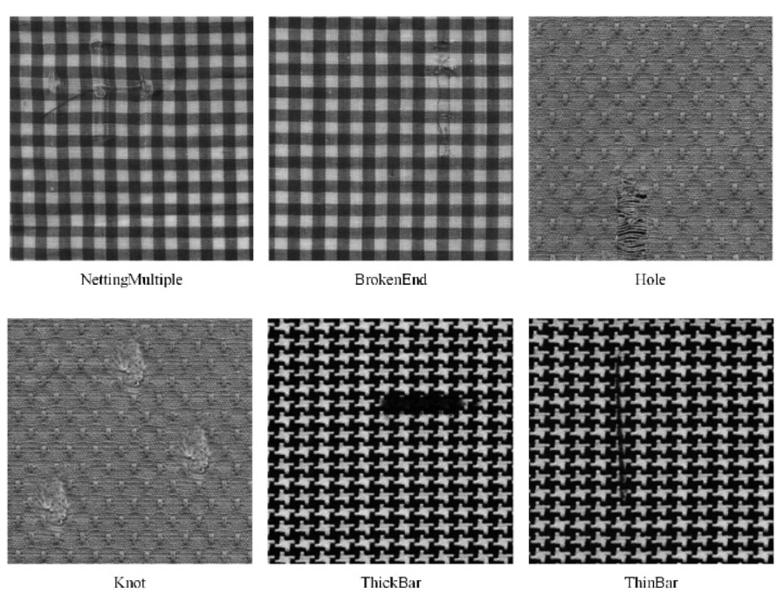
The typical defect samples of patterned texture fabric images. The defects include netting-multiple, broken-end, hole, knot, thick-bar, and thin-bar.

Slide 13
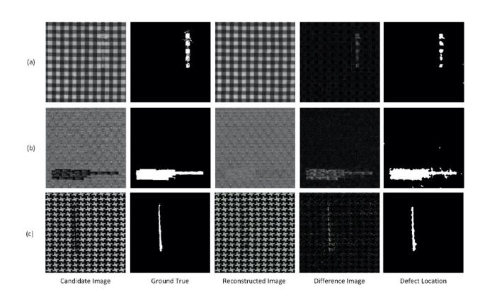
Samples of defect detection by the proposed model on (a) box-patterned, (b) dot-patterned, and (c) star-patterned fabric image.

Slide 14
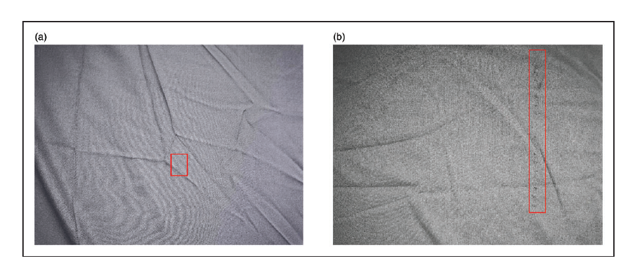
Two sample images with defects in the dataset:
(a) a fabric image with a small defect (Reed Misdraw)
(b) a fabric image with an obvious defect (Clip Mark).

Slide 15
Automated Fabric Defect Detection and Classification
DKM Consultant Ltd

Slide 16
High Level AI Flow

Slide 17
AI Approach
DKM’s AI-based automated fabric defect detection algorithm utilizes pre- trained deep neural network models for classifying possible fabric defects.
The fabric images are enhanced by pre-processing at various levels using conventional image processing techniques and they are used to train the networks.
The Deep Convolutional Neural Network (DCNN) and a pre-trained network, AlexNet, are used to train and classify various fabric defects.
With current capability, the detection and classification system based on this classifier model can aid the human to find faults in the fabric manufacturing unit.

Slide 18
Real time image samples of defects

Slide 19
DKM’s AI Strategy

Slide 20
Image Appearance during AI Workflow

Slide 21
Fabric defect detection system

Slide 23
How to AI Model output looks like?

Slide 25
Pixel by Pixel Comparison
Three kinds of defects on the fabric surface. (a) Regional defects in fabrics; (b)Weft defect
in fabric; (c)Warp defect in fabric

Slide 26
The typical defect samples of patterned texture fabric images. The defects include netting-multiple, broken-end, hole, knot, thick-bar, and thin-bar.

Slide 27
Samples of defect detection by the proposed model on (a) box-patterned, (b) dot-patterned, and (c) star-patterned fabric image.

Slide 28
Two sample images with defects in the dataset:
(a) a fabric image with a small defect (Reed Misdraw)
(b) a fabric image with an obvious defect (Clip Mark).

Slide 29


